Slide 1
Computer Principles for Programmers
User Interfaces, Powershell, and Time Management

Slide 2
Quiz

Slide 3
News of the Week

Slide 4
Agenda: Lecture
What is “Command Line Interface” (CLI)? What is “Graphical User Interface” (GUI)?
Human Computer Interaction: from simple User Interfaces to the User eXperience CLI → TUI → GUI → UX
Introducing PowerShell as the new Windows CLI
Windows 10 relationship between PowerShell and File Explorer
Time Management

Slide 5
Agenda: Activity
Activity:
An activity to use Windows PowerShell
An activity on the principles of time management

Slide 6
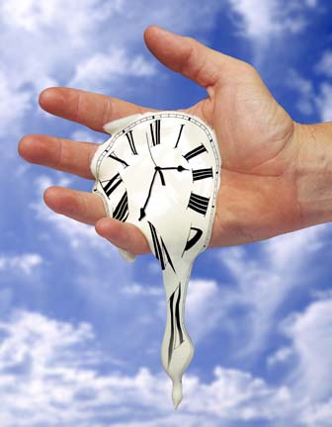
Time Management … do it first
The cost of anything is the amount of life you exchange for it. – Henry David Thoreau
Notes:
Appropriately, we are doing this topic first. Yes, it was last on the agenda but that’s the whole problem with time management: we leave it to the end when there isn’t enough time. It’s not related to the other topics today but we had to put it somewhere. Perhaps ironically, this week and this far into the course seemed about the right time. By the mid-point of the term, most of us have discovered we don't have enough time.
We say Time Management but time cannot be managed. You cannot be in charge of time, or control it, or order it around.
How is it that time and time again we don't have time? We do too many things at the same time, find ourselves working against time…and all these things happen all the time. Where does the time go? Tempus Fugit – Time has been fleeing since 29BC when Virgil wrote those words. We wish we could make the time, find the time, have some free time, get some time, put in the time, want to be ahead of our time, not behind the times, don't want to get old before our time. We always need more time, don't want it to be a waste of our time. The best time to run out of time is when having a rough time. When bored, we find a way to pass the time. See https://en.oxforddictionaries.com/definition/time
Only musicians "keep time".
Time: rich or poor, everyone gets 24 hours, replenished daily. Time is not something we have, time is something we are given. Time is a choice we make.
Note: Procrastination is the world's most popular form of time management.
"I didn't have time." This actually means it wasn't important enough, it wasn't a high priority, fun, distracting, profitable, or urgent enough to make it to the top of the list.
Every few days, Twitter and Facebook soak up a billion hours of 'spare' time. Where did that time come from? What did we do before social media was here? Weren't we busy before 2007?
Running out of time is mostly a euphemism, and the smart analyst realizes that it's a message about something else. Time is finite, but, unlike money, time is also replenished every second. http://sethgodin.typepad.com/seths_blog/2014/04/i-didnt-have-time.html
http://www.bakadesuyo.com/2017/03/how-to-stop-checking-your-phone/
the actual Thoreau quote is “…the cost of a thing is the amount of what I will call life which is required to be exchanged for it, immediately or in the long run,” Walden, “Economy”

Slide 7
Stacks versus Queues
Email, To Do Lists
Calendar, Project Plan
Push
Pop
3
2
1
In
3 | 2 | 1
Out
LIFO stacks deal with the immediate.
FIFO queues deal with the important.
Notes:
To do lists and your Inbox are a stack, Last In, First Out. Stacks deal with the immediate. Emails more than a week old may never be answered.
The calendar schedule and project plan is a queue: First In, First Out. Queues deal with the important activities that are planned and scheduled. The passage of time conveniently organizes your queue but only if you schedule your to-do list tasks and stick to the schedule.
Scheduling a task means estimating time for something you may never have done before. Make your best guess. The more your guesses are wrong today, the less they will be wrong tomorrow.
"The first 90% of the code accounts for the first 90% of the development time. The remaining 10% of the code accounts for the other 90% of the development time." -- Tom Cargill, Bell Labs
Elapsed time is not proportional to working code! It takes only half the time to write the first 90% of the code.
Standard estimation for programming tasks: most realistic and honest estimate (includes coffee input, coffee output, breaks, and distractions) × 2 (experts) to 4 (the rest of us)
Hofstadter's Law: It always takes longer than you expect, even when you take into account Hofstadter's Law.
— Douglas Hofstadter, 'Gödel, Escher, Bach: An Eternal Golden Braid[1]
There is never time to do it right the first time but there is always time to fix it later ... or ... If you don't have the time to do it right, when do you think you're going to find the time to do it over?
James Gleik: "Recognize that neither technology nor efficiency can acquire more time for you, because time is not a thing you have lost. It is not a thing you ever had." "You can't waste time and you can't save time; you can only choose what you do at any given moment." from “James Gleick's Survival Lessons” in Wired 7.08 http://archive.wired.com/wired/archive/7.08/gleick.html
See also http://eisenhower-matrix.com/ -- The 2 X 2 matrix of urgent/not and important/not
http://eisenhower-matrix.com/first-things-first/ – Steven Covey's version
https://www.google.ca/search?q=eisenhower+covey or https://www.google.ca/search?q=eisenhower+matrix+covey

Slide 8
A most important rule
EAT the FROG
in the
MORNING
Notes:
This comes from a Mark Twain quote: “Eat a live frog first thing in the morning and nothing worse will happen to you the rest of the day.”
Do the task that is the most distasteful, the most difficult, the least appealing to you first thing in the morning…and you won't have to look forward to it all day long. It will also get done.
Redefine wealth and value as time and attention, and success becomes using time effectively and being intentional with our focus. Very successful people often spend their first work hours away from the distractions of the office, email, smartphones, and the Internet to focus only on their most important task for the day—then they go to the office and interact with the world.
Put the big rocks in first!
https://www.popsugar.com/smart-living/Mayonnaise-Jar-Two-Cups-Coffee-Story-34745305
https://www.youtube.com/watch?v=Zc3tWGoQq5E&ab_channel=AlanOPinoy
https://xkcd.com/1658/
http://www.explainxkcd.com/wiki/index.php/1658
https://en.wikipedia.org/wiki/Hofstadter's_law

Slide 9
In a letter from Arianna Huffington to Elon Musk...
People are not machines. For machines -- whether of the 1st or 4th Industrial Revolution variety -- downtime is a bug; for humans, downtime is a feature. The science is clear. And what it tells us is that there’s simply no way you can make good decisions and achieve your world-changing ambitions while running on empty.
Notes:
Also, you are much more likely to get sick if you are short on sleep making you even less efficient and creating even more of a time crunch.

Slide 10
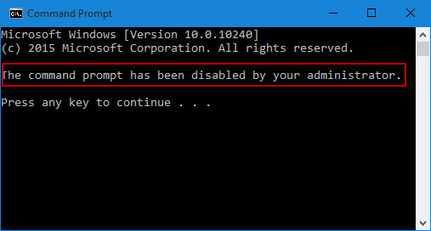
CLI – Command Line Interface
Because rd does not mean Restore Data C:\>rd /s/q .
(don’t do this)
Notes:
The command line is the original computer user interface. It is a simple prompt for the entry of a command by the user and a response from the operating system.
It is quite powerful but not particularly “user friendly”. Thus, the command line restriction on many corporate users’ PCs.
RD does not mean Restore Data, or Reset Default, Resolve Discrepancy, Reinstate Deletions, Repair Damage, Rebuild Database, Refurbish Defect, Re-establish Debugging, or Rectify Difficulties, … it means Remove Directories and Real Disaster.
Notes for ICT people using FTP with command line or GUIs can be found at
http://inside.senecacollege.ca/mylearning/ICT , Learning FTP
https://www.lynda.com/FTP-tutorials/Welcome/189068/364887-4.html?org=senecacollege.calege.ca

Slide 11
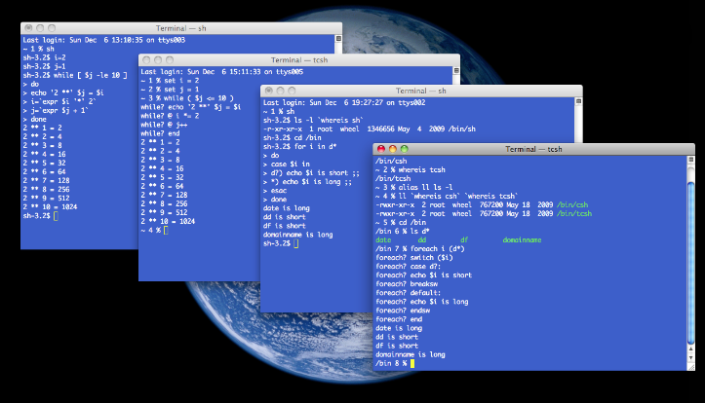
Windows cmd, bash shell on Linux
Fast, unambiguous, easy to document, script-able, macro-able.
Unusable without a manual or a good memory.
Be careful > sudo rm -rf / (don’t do this)
Notes:
To use applications, the user first learned to use the OS.
Today, only administrators use the command line.
RM can mean Really Mucked-up
https://aws.amazon.com/s3/
Amazon Simple Storage Service (Amazon S3) is object storage with a simple web service interface to store and retrieve any amount of data from anywhere on the web.
Customers use Amazon S3 as primary storage for cloud-native applications; as a bulk repository, or "data lake," for analytics; as a target for backup & recovery and disaster recovery; and with serverless computing.
How a typo took down S3, the backbone of the internet
http://www.theverge.com/2017/3/2/14792442/amazon-s3-outage-cause-typo-internet-server
https://aws.amazon.com/message/41926/ https://status.aws.amazon.com/
On Feb.28, 2017 at 9:37AM PST [while debugging an issue in the S3 billing system] an authorized S3 team member using an established playbook executed a command which was intended to remove a small number of servers for one of the S3 subsystems that is used by the S3 billing process. [No problem, S3 has a massively redundant architecture.] Unfortunately, one of the inputs to the command was entered incorrectly and a larger set of servers was removed than intended. [This caused a cascading failure in numerous dependent systems causing] each of these systems to require a full restart. …we have not completely restarted the index subsystem or the placement subsystem in our larger regions for many years. S3 has experienced massive growth over the last several years and the process of restarting these services and running the necessary safety checks to validate the integrity of the metadata took longer than expected. … finished recovery at 1:54PM PST. At this point, S3 was operating normally. Other AWS services that were impacted by this event began recovering. Some of these services had accumulated a backlog of work during the S3 disruption and required additional time to fully recover.
https://aws.amazon.com/s3/sla/
“Monthly Uptime Percentage” is calculated by subtracting from 100% the average of the Error Rates from each five minute period in the monthly billing cycle.
8766 = avg number of 5 minute periods in a month (=365.25 days per year * 24 hours per day * 12 five minute periods per hour / 12 months)
51.4 = number of 5 minute periods in 4 hours, 17 minutes of 100% downtime =(4 hours * 60 minutes + 17 minutes ) / 5 minute periods
99.41% uptime qualifies for a 10% service credit – was that enough to compensate your business for 4+ hours of downtime?
$2,000+ is the conservative cost of 4+ hours of downtime for a $1M/year business divided by 2000 hours/year (50 weeks * 40 hrs/wk)
AWS S3 would cost about $10 (ten dollars) a month resulting in a $1 (one dollar) saving for ½ day of downtime. You've only lost $1999 instead of $2000.
See http://www.hostingadvice.com/how-to/aws-s3-pricing/

Slide 12
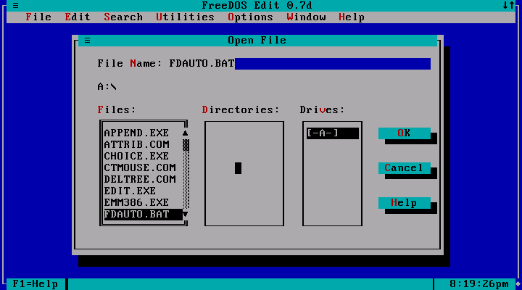
Console Apps and Textual User Interface
25 rows
80 columns
character graphics
Notes:
"bad user interfaces are a kind of bug that manifests when software runs on people" -- Tonio Loewald (taloewald@ua.edu), Analyst/Programmer at the University of Alabama Libraries.
This was the next evolution from the prompt – response Cmd Line Interfaces to a full screen text interface.
A TUI (Text-based User Interface, or Textual UI, or Terminal UI) displayed Extended ASCII graphical characters on an addressable 25 line x 80 character text screen.
Most TUIs accepted mouse and keyboard shortcut inputs. These interfaces were a huge leap forward in making systems much more usable than the simple command line interface. Note the reduction in memory load: you don't have to remember the cryptic command name with its equally cryptic syntax to manage files here. The interface prompts the user as to what to do, the software remembers how to do it.
Replace human memory requirements (knowledge of commands and filenames) with visual information shown on screen.
https://en.wikipedia.org/wiki/Console_application
https://en.wikipedia.org/wiki/Text-based_user_interface
The classic UNIX textual user interface editor known as vi was replaced by vim (vi improved) in 1991, vim is now up to version 8.0.0022 released 2016-10-03

Slide 13
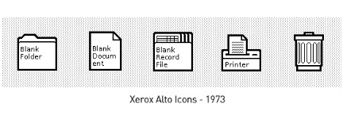
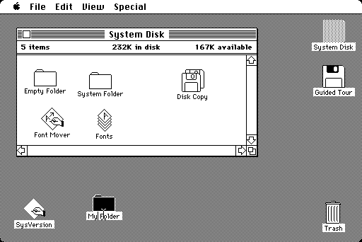
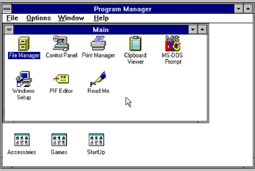
“Graphical User Interface” (GUI)
Notes:
The early GUI from Xerox PARC – Palo Alto Research Center in California.
They created the GUI in the 1970s but management could not see how it would be useful for making photocopies.
Steve Jobs and others at Apple already knew that icons would be useful for a new interface on the next generation of Apple computers. Seeing an actual implementation of a GUI on the Xerox "alto" in 1979 helped greatly. Xerox allowed Apple to use their GUI ideas in exchange for a large block of Apple stock
Original Macintosh desktop https://en.wikipedia.org/wiki/File:Apple_Macintosh_Desktop.png
Microsoft saw the new Lisa and Macintosh computers from Apple and thought it was a good idea, too.
The first people to get rich from GUIs were lawyers when Xerox, Apple, and Microsoft sued each other throughout the 1980s and beyond.

Slide 14
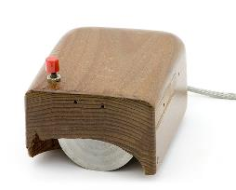
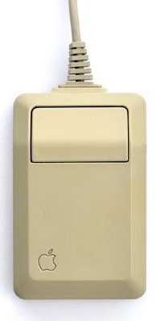
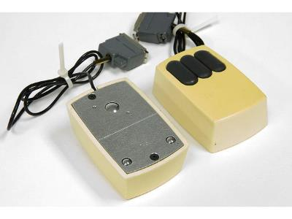
GUI’s enabling tech: Mice + bit mapped screens
Xerox PARC, 1972 $300 2017 $1,800
Macintosh, 1984 $15 2017 $32.50
Doug Engelbart’s prototype, 1964
Notes:
The mouse was the key invention enabling the GUI. A natural pointing gesture replaced keyboard navigation.
Mouse movements were related to a bit mapped screen as opposed to a text screen with rows and columns of characters
https://www.techspot.com/guides/477-xerox-parc-tech-contributions/
http://www.computerhistory.org/revolution/input-output/14/350
http://www.computerhistory.org/revolution/input-output/14/350/1545?position=0
https://en.wikipedia.org/wiki/Apple_Mouse
http://www.cultofmac.com/95614/how-steve-jobs-invented-the-computer-mouse-by-stealing-it-from-xerox/
http://dynamis.no/apple-mouse-collection/
https://en.wikipedia.org/wiki/The_Mother_of_All_Demos
Today, touchscreens enable the user to interact directly with what is displayed, rather than using a mouse, touchpad, or any other intermediate device.

Slide 15



GUI versus CLI
Slower but flexible.
Casual users, “User-friendly”
Minimal training. Functions require multiple steps.
Form and Function.
Faster but inflexible.
Administrators experts and only.
Act on many items & objects with a single command.
Function, little Form.
Notes:
Programmer Alert: Good GUI design for expert users includes keyboard shortcuts. E.g. MS-Word and Visual Studio.
No administrator is going to point, click, and edit a thousand user profiles, file permissions, etc.
https://www.interaction-design.org/literature/book/the-encyclopedia-of-human-computer-interaction-2nd-ed/affordances
https://en.wikipedia.org/wiki/History_of_the_graphical_user_interface

Slide 16
Benefits of using GUI
The GUI created end-user computing. Real people (not just geeks and nerds) used computers without extensive training, detailed manuals, or memorization of codes and commands.
The intuitive GUI reduced the ‘barrier to entry’ (command line and text interfaces) allowing broad business deployment of PCs especially for general “Office” applications.
The Iconic Apple 1984 Superbowl ad, PC vs Mac, Macintosh intro characterize CLI vs GUI. The best Apple ad (details).
Notes:
Other enabling technologies, in addition to manual pointing devices like the mouse, were technical developments in the speed and power of CPUs, memory, video processing, and I/O bandwidth (motherboards). The GUI added significant overhead to computer operating systems: from the mid 1980s to mid 1990s, PCs seemed to gain only features, not speed; advances in hardware were used up by software advances in GUIs, OSs, and apps. It took a few years before new PCs with GUIs outperformed old PCs with a text interface.
Event-driven programming concepts came to the personal computer world. It changed the conceptual model of computer systems from structured, procedural coding where, for the most part, the programmer was in control of what the user could do to a collection of event handlers which listened for unpredictable interrupts such as mouse movements and clicks – the PC became a stimulus/response machine instead of a taskmaster. See https://en.wikipedia.org/wiki/Event-driven_programming

Slide 17
HCI Human Computer Interaction: CLI to TUI to GUI to UX
GUI led to the study of Human Computer Interaction
User Interface has now become UX User Experience
Is it...useful? easy to use? easy to start using? easy to keep using?
Ergonomics of human-system interaction (ISO 9241-210)
ISO factors that influence user experience: system, user, design, usability, and the context of use.
…because, ultimately, your software runs on the user
See user interface design, information design, and interaction design.
Notes:
Is your GUI “an impenetrable confusion of forms, colours and noises”? See Deiter Rams’s ten principles for good design https://www.vitsoe.com/us/about/good-design
Good design: makes a product useful and understandable, is innovative, unobtrusive, honest, long-lasting, thorough, aesthetic, and is as little design as possible.
Bells and whistles, features, functions, cool screen widgets, and clever code are the hallmarks of programmers’ egos…done to impress themselves and other programmers. Users suffer the consequences. E.g. make clickable links obvious, like the simple visual affordance of the underline in the good old days. Hiding it, because you are clever enough to know how, turns the major advantage of a GUI—its visual nature—into something worse than a command line interface: it becomes a tedious pixel hunt for features. An empty command line is not particularly user-friendly but at least there is a way to discover its features with manuals and help text. A GUI's hidden features, perhaps to avoid a cluttered interface, are knowable only upon mouse-over. A standard 1920 x 1080 screen contains over 2 million pixels. That's a lot of mousing.
In general UX is concerned with how people feel about a system.
value (is it useful?), usability (‘is it easy to use?’), adoptability (is it easy to start using?’), and desirability (is it fun and engaging?’). (Guo, 2012. see http://www.uxmatters.com/mt/archives/2012/04/more-than-usability-the-four-elements-of-user-experience-part-i.php)
https://www.iso.org/standard/52075.html
ISO (International Standards Organization) 9241-210:2010 provides requirements and recommendations for human-centred design principles and activities throughout the life cycle of computer-based interactive systems. It is intended to be used by those managing design processes, and is concerned with ways in which both hardware and software components of interactive systems can enhance human–system interaction.
https://en.wikipedia.org/wiki/User_experience
https://en.wikipedia.org/wiki/Human%E2%80%93computer_interaction
https://senecacollege-primo.hosted.exlibrisgroup.com/primo-explore/fulldisplay?docid=TN_loughborough2134/15600&context=PC&vid=01SENC&search_scope=default_scope&tab=default_tab&lang=en_US
Using human factors standards to support user experience and agile design
Abstract: The ISO 9241-210 standard provides a framework for human-centred design (HCD) activities comprising the four stages: context of use, specification of user and organisational requirements, design solutions, and evaluation against requirements. Other parts of the 9241 standard cover user interface design and usability. This paper uses the HCD framework to emphasise user experience (UX) design and methods used to help create good user experiences. It also relates the framework to an agile software development environment. It is concluded that the flexible and iterative nature of ISO 9241-210 makes it a good basis for both user experience design and an agile development process.

Slide 18
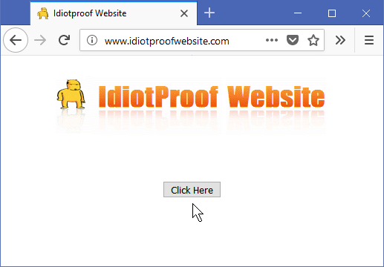

GIGO – Garbage In, Garbage Out
Avoid Garbage In with a good UX and intelligent edits.
http://www.idiotproofwebsite.com/ is as good as it gets.
"idiot-proofing" is solving the wrong problem.
Problem: understanding the problem in enough detail to solve it.
Notes:
[NOTE: this slide makes more sense if viewed in presentation mode.]
Slide text:
Avoid Garbage In with a good UX and intelligent edits.
http://www.idiotproofwebsite.com/ is as good as it gets.
"idiot-proofing" is solving the wrong problem.
Problem: understanding the problem in enough detail to solve it.
Garbage In, Garbage Out is an axiom of computing. But…
It is impossible to make anything foolproof because fools are so ingenious.
Nothing is foolproof to a sufficiently capable fool.
Make something idiot-proof, and they will build a better idiot.
(https://en.wikiquote.org/wiki/Talk:Murphy%27s_law)
Idiotproof-Website since 2006
http://www.sitepoint.com/forums/showthread.php?444973-Idiotproof-Website

Slide 19
Make a simple wooden fence twenty metres long.
You have ten fence-boards, each two metres long. How many fence-posts do you need?
11… as a visual building problem. This is a UI design error.
10 … as a thinking math problem.
Notes:
[NOTE: this slide makes more sense if viewed in presentation mode.]
[slide editing note: animation overlays text box at bottom of screen.]
From http://philosophtly.blogspot.ca/2009/06/myth-of-idiot-proofing.html
Make a simple wooden fence twenty metres long. You have ten fence-boards, each two metres long. You go to the lumber mill to get fence-posts -- how many do you need?
This is a user interface error. Many people make the mistake when thinking of it as a math problem: 20m fence = 10 × 2m fence boards = 10 posts.
No one makes this error if they draw the fence with boards and posts. When you draw it and see it, it is an easily solvable building problem.
https://en.wikipedia.org/wiki/Off-by-one_error

Slide 20

1
10 2
9 With more questions to 3
understand the problem in enough detail, the solution needs 10 posts to put a
8 fence around a big hole. 4 7 6 5
Notes:
But, 10 posts is the correct number if you understand the problem in enough detail: the purpose of the fence is to encircle a big hole, 6m in diameter.

Slide 21
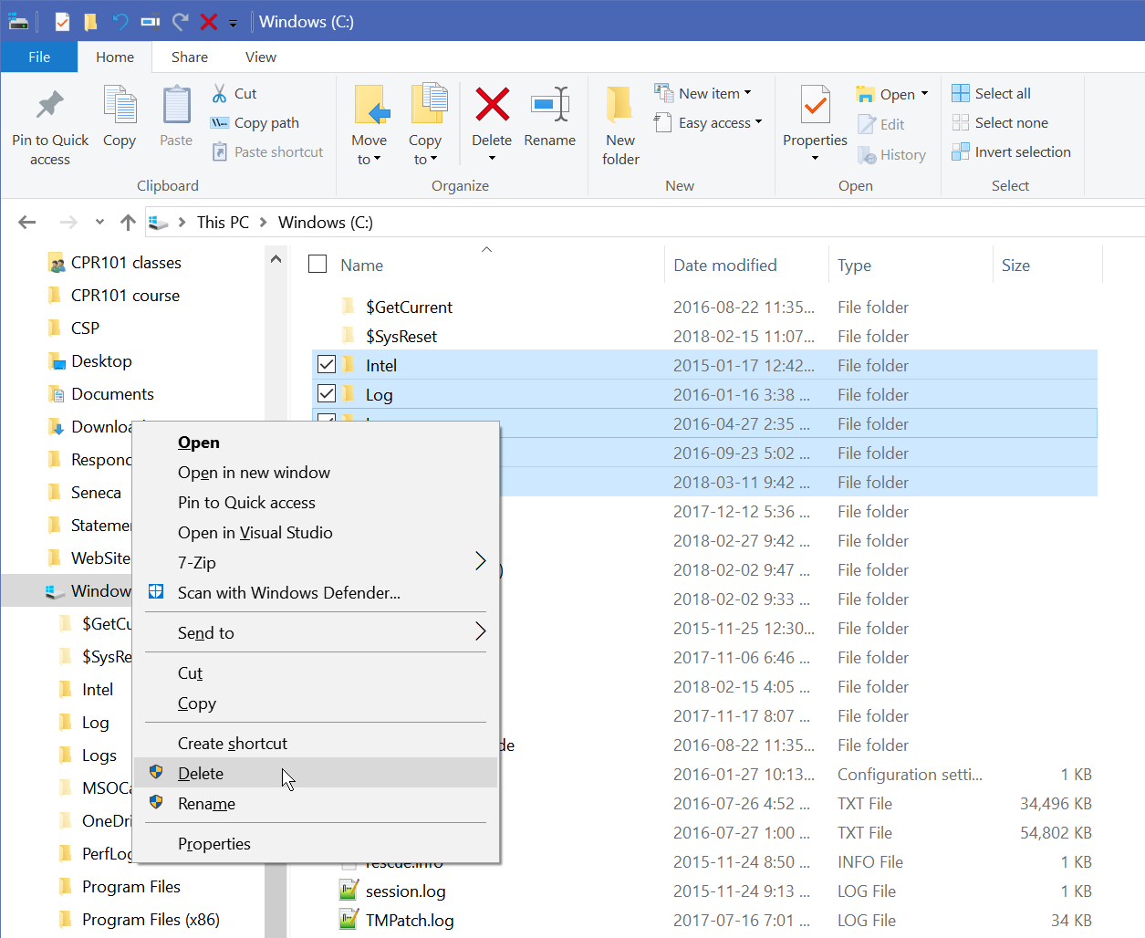
RU sure?
Are you sure about those really complex, irreversible, life changing things you indicated on the previous screen that this dialog box is covering up?
Nope, I'm just wasting my time here.
Yes, I'm sure I did what I thought I meant to do.
Notes:
Make confirmation dialogs meaningful.
https://ux.stackexchange.com/
https://ux.stackexchange.com/questions/756/what-are-some-alternatives-to-the-phrase-are-you-sure-you-want-to-xyz-in-confi
https://ux.stackexchange.com/questions/71960/deletion-confirm-or-undo-which-is-the-better-option-and-why
https://developer.microsoft.com/en-us/windows/desktop/design

Slide 22
No more Error messages…
Give user support, diagnostic, and help messages
Say why the message is issued…not this:
Bad command or filename. [ classic DOS error ]
Input contains invalid character. [ guess which one! ]
Input value out of range. [ guess the min – max ]
Don’t confuse input with output
Users do not have to format their input the same way the program edits and outputs
postal codes may/may not contain a space
Phone numbers, dates – just capture the digits and format the output
Put the messages where the users can see them
Notes:
Cleanse the user's input when safe to do so. Usually:
Trim input of leading and trailing blanks TRIM(string)
Change multiple spaces to single space WHILE " " is found in string, REPLACE " " WITH " "
Store addresses in UPPER case UPPER(string)
Store names in UPPER case. Mixed case can be used IF your DB does case independent searches AND (end user inputs their name as it will appear OR expert staff is aware of the many cultural variations)
N.B. Do NOT prompt a user for First and Last names. First and Last is culturally relative. Sometimes it is GIVEN and FAMILY name, sometimes it is FAMILY and GIVEN name. Prompt for GIVEN and FAMILY.
Do not store edited values.
Store a postal code as six char. output as LEFT(string,3) & " " & RIGHT(string,3)
Store a phone number as 10 digits with country code stored separately. Output phone as nnn-nnn-nnnn or (nnn)nnn-nnnn or nnn.nnn.nnnn

Slide 23
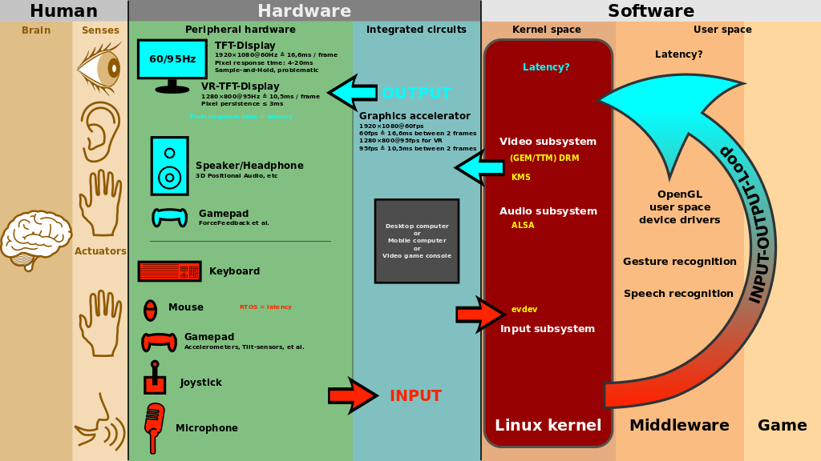
Notes:
The UX is critical for games to be successful. Good games interact with the user via multiple senses.
interactive news – a very different experience from reading the article in a real newspaper
https://www.theglobeandmail.com/report-on-business/how-5g-will-change-your-life/article38009527/
https://www.theglobeandmail.com/news/world/amazon-rainforest-deforestation-crisis/article37722932/
https://upload.wikimedia.org/wikipedia/commons/thumb/a/a1/Linux_kernel_INPUT_OUPUT_evdev_gem_USB_framebuffer.svg/1024px-Linux_kernel_INPUT_OUPUT_evdev_gem_USB_framebuffer.svg.png
Attribution: Shmuel Csaba Otto Traian
https://commons.wikimedia.org/wiki/File:Linux_kernel_INPUT_OUPUT_evdev_gem_USB_framebuffer.svg
From https://en.wikipedia.org/wiki/Human%E2%80%93computer_interaction#Design

Slide 24

PowerShell is the new CLI for Windows – Linux – macOS – ARM
Notes:
https://www.ghacks.net/2018/01/12/powershell-vs-powershell-core-what-you-need-to-know/
https://docs.microsoft.com/en-ca/powershell/scripting/setup/installing-powershell-core-on-macos?view=powershell-6

Slide 25
PowerShell is the new CLI
PS command-line shell and scripting language for administering
multiple operating systems (Windows, macOS, *nix)
processes related to running applications on those OS
e.g. management of Networks, Devices, Users, App runtime environment
Object-Oriented structure, built-in script editor, thousands of cmdlets, pronounced 'command-lets', to fully manage a system.
PowerShell is more secure than DOS CMD. All old batch CMD commands work in PowerShell (backward compatibility).
Audio/Visual Learning: https://www.lynda.com/IT-tutorials/Why-PowerShell/486042/496255-4.html
Notes:
PowerShell is a task-based command-line shell and scripting language; it is designed specifically for system administrators and power-users, to rapidly automate the administration of multiple operating systems (Linux, macOS, Unix, and Windows) and the processes related to the applications that run on those operating systems. https://docs.microsoft.com/en-ca/powershell/scripting/powershell-scripting?view=powershell-6
the ISE (Integrated Scripting Environment) is the built-in script editor. It looks like a simple command-line window but has numerous features beyond the traditional command interface
CMD = Command Prompt, also known as cmd.exe or cmd, is the command-line interpreter

Slide 26
one-to-one relationship between PowerShell and File Explorer
There is a one-to-one relationship between the command line and File Explorer, especially in Windows 10.
You can move from one to the other from any folder in Windows and copy any paths.
Learning to take advantage of this feature will greatly improve your speed in programming and using Windows.
Next slides are a few examples of such a relationship.

Slide 27
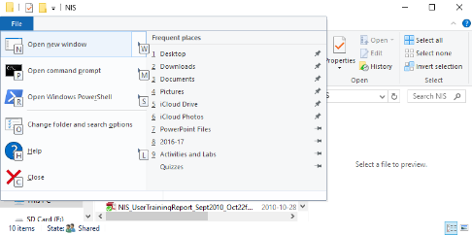
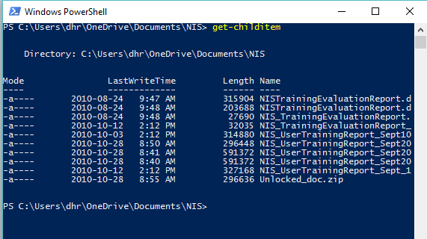
Opening PowerShell from File Explorer
Navigate to any Folder in File Explorer.
Type ALT + F to open the file menu and then, press R to open PowerShell.
> get-childitem
Here you can see a typical run.
Notes:
get-childitem without options produces the same output as dir.
It can get the child items of other objects besides the current directory.
Get-ChildItem -Path "C:\Windows\Logs\*"
Get-ChildItem -Path "HKLM:\Software"
https://msdn.microsoft.com/en-us/powershell/reference/5.1/microsoft.powershell.management/get-childitem

Slide 28
Some shortcuts used in PowerShell
These are some of the shortcuts which could be used inside PowerShell:
Arrow Up or Down to recall commands in the stack
Home, End, Ctrl+Arrow Left/Right to edit within the cmd
get-history lists all commands in the stack
get-help
TAB key auto completes, similar to Visual Studio's Intellisense
Cmdlet names
cycles through file names in current folder. Wildcards optional e.g. *.txt [TAB] will retrieve text file names
Notes:
https://technet.microsoft.com/en-us/library/ff678293.aspx

Slide 29
Notes
…not on the quiz but here for further information and explanation.

Slide 30
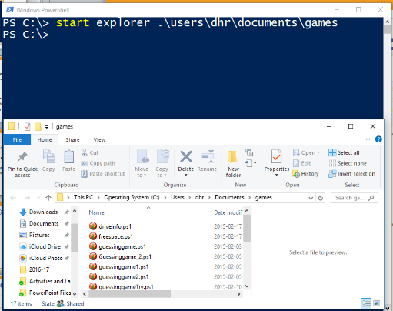
Opening File Explorer from PowerShell
At the Windows PowerShell prompt, type Start Explorer .\ to open File Explorer in the current directory.
You could also pass a directory path to open File Explorer in that path.

Slide 31
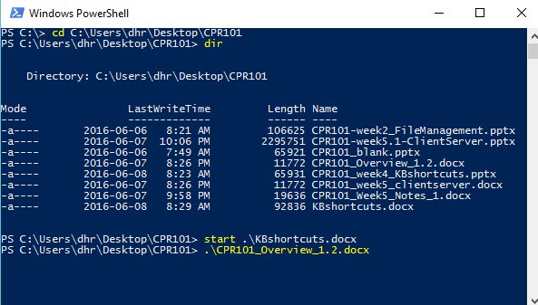
Opening a File or Folder from PowerShell
PowerShell can recall folder and file names in the current directory to the cmd line.
To open a file or folder, type .\ or start .\ then press TAB and cycle through listing (Shift + TAB to go in reverse.)
Stop at a file you want to open and press ENTER; it has the same result as double clicking in File Explorer.
Notes:
e.g.
.\ [TAB]
.\*doc? [TAB]
.\*.ppt? [TAB]

Slide 32
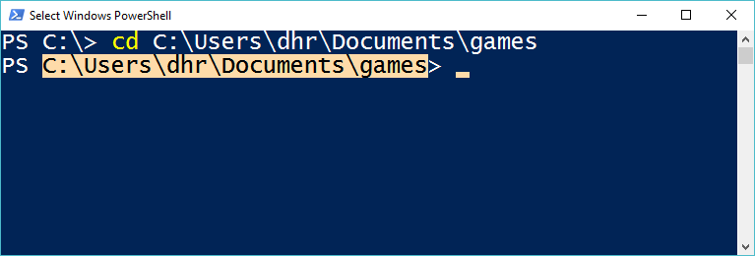
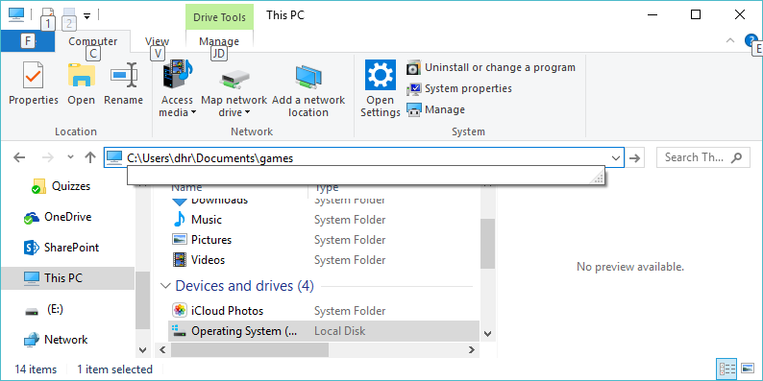
Copying Paths From PowerShell to File Explorer
You can copy paths from PowerShell and paste them into File Explorer. This saves a lot of typing.
To do so, left click at beginning of text and drag mouse to the end of text. This highlights the text.
Then press CTRL + C or the ENTER key to copy to Clipboard.
Right click and select Edit Address in File Explorer, type CTRL + V to paste the new address and press ENTER to move to the directory.

Slide 33
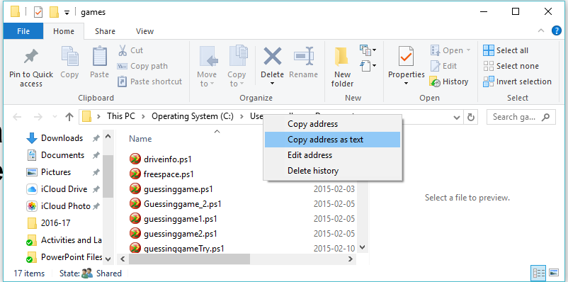
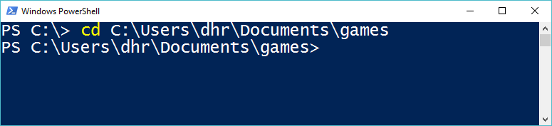
Copying Paths from File Explorer to PowerShell
You can copy paths from File Explorer and paste them into PowerShell as well.
To do so, right click on the address bar in the File Explorer and select copy address as text.
Then, right click in PowerShell and paste after command.

Slide 34
Time Management Definition (trad.)
Time management is the act or process of “planning and exercising conscious control over the amount of time” spent on specific activities, especially to “increase effectiveness, efficiency or productivity.”
Effective time management can help “increase productivity and reduce stress.” By learning and applying some time management skills and techniques, increase your chance “to stay organized, keep a clear mind, and be more productive” (in work, study, and life.)

Slide 35
What is “Command Line Interface” (CLI)?
To use applications, the user first learned to use the OS.
Today, only administrators use the command line.
Early computers: a user would run a command asking the operating system to complete a task. It was a line-by-line, prompt – response.
The most used PC operating system in the 1980s was MS-DOS, Microsoft’s version of the Disk Operating System. This OS used a text prompt relative to a drive (e.g. C:\> ) for entry of commands to execute programs, manage files, and configure the system. Today, see FreeDOS
A CLI (Command Line Interface) is “a user interface to a computer's operating system or an application” in which the user responds to a visual prompt by “typing in a command on a specified line,” receives a response back from the system, and then enters another command, and so forth. (http://searchwindowsserver.techtarget.com/definition/command-line-interface-CLI)
Notes:
https://en.wikipedia.org/wiki/Command-line_interface
Unix and DOS successfully used the CLI for years. E.g.
vi code editor distributed in 1979 with BSD unix

Slide 36
What is “Graphical User Interface” (GUI) and what are some common GUI elements?
A Graphical User Interface (GUI which is sometimes pronounced ‘gooey’) is “a human-computer interface” (i.e., a way for humans to interact with computers) that “uses windows, icons, menus, etc., and which can be manipulated by a mouse and/or touch” (and often to a limited extent by a keyboard as well.) (http://www.linfo.org/gui.html)
GUI Includes all of the graphical elements that we associate with modern computing, such as:
Icons
Menus
Buttons
Mouse cursor
…

Slide 37
A brief history of GUI
There has always been this question that “who invented GUI?” The modern GUI, much like most of modern computing, was invented piecemeal, with many individuals inventing parts that eventually became consolidated into a whole product.
The first organization to really put together the GUI in a working model was Xerox, at their Palo Alto Research Center (Xerox PARC.)
They created the GUI but management could not see how it would be useful for making photocopies.

Slide 38
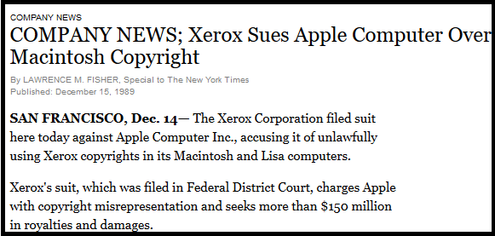
A brief history of GUI (Cont’d) - Early GUI Piracy?
Steve Jobs paid Xerox management in stock to let him and his programmers look at their GUI system.
He and his staff appropriated many of the elements and they became the basis for the Apple Lisa and eventually the Apple Macintosh.
Xerox sued Apple and Apple settled out of court with Xerox.

Slide 39
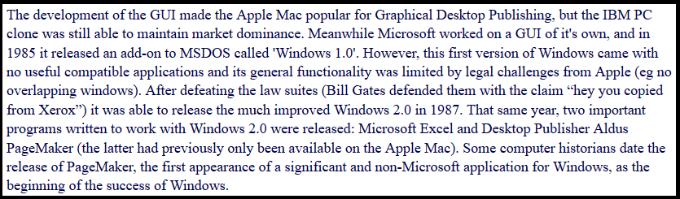
A brief history of GUI (Cont’d) – Microsoft emerges
Bill Gates at Microsoft appropriated these ideas from Apple and used Microsoft’s near-monopoly on the PC market to bring the Windows GUI to end users: (http://www.theoligarch.com/microsoft_vs_apple_history.htm)

Slide 40
CLI and Command Line in Windows
Despite all these facts, there are some cases like network administration or working directly with commands inside configuration files, which using CLI might still be a better and preferred option.
The Command Line (or CMD.EXE) that you access on a modern Windows computer is a clone of MS-DOS which has many limitations (like no networking capabilities, no built-in mouse or other device drivers, no multi-user support, no encryption or security support, etc.)
It’s interesting that when DOS was originally built, these issues were not seen as relevant to the operating system!

Slide 41
CLI and Command Line in Windows (Cont’d)
Due to it’s obvious limitations, the Command Line in Windows fell out of use by most system administrators.
Microsoft realized this and rather than continue to update it, decided to build a new command line and scripting language, on the .NET infrastructure.
The old CMD.EXE command interpreter was planned to be replaced by PowerShell.

